Slide 1
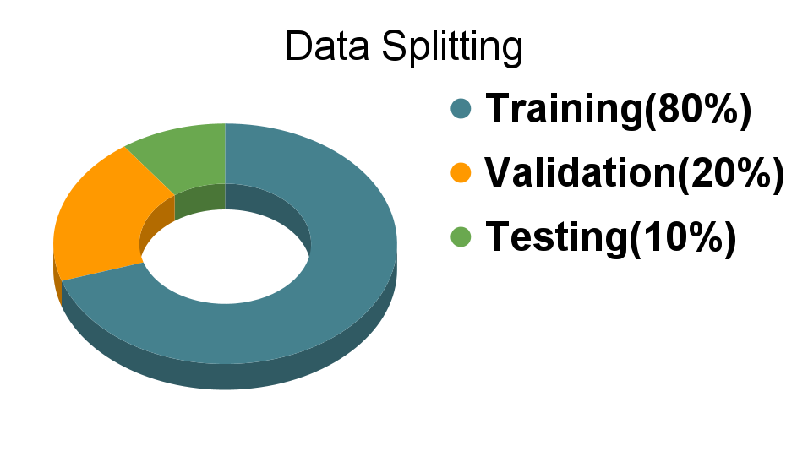
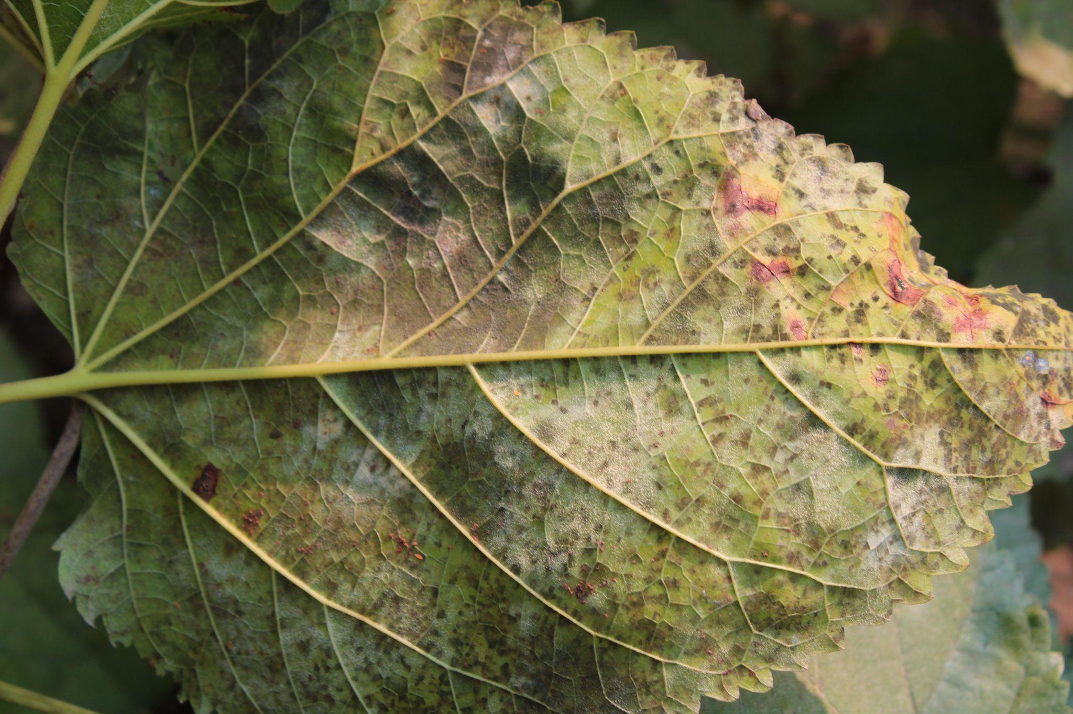
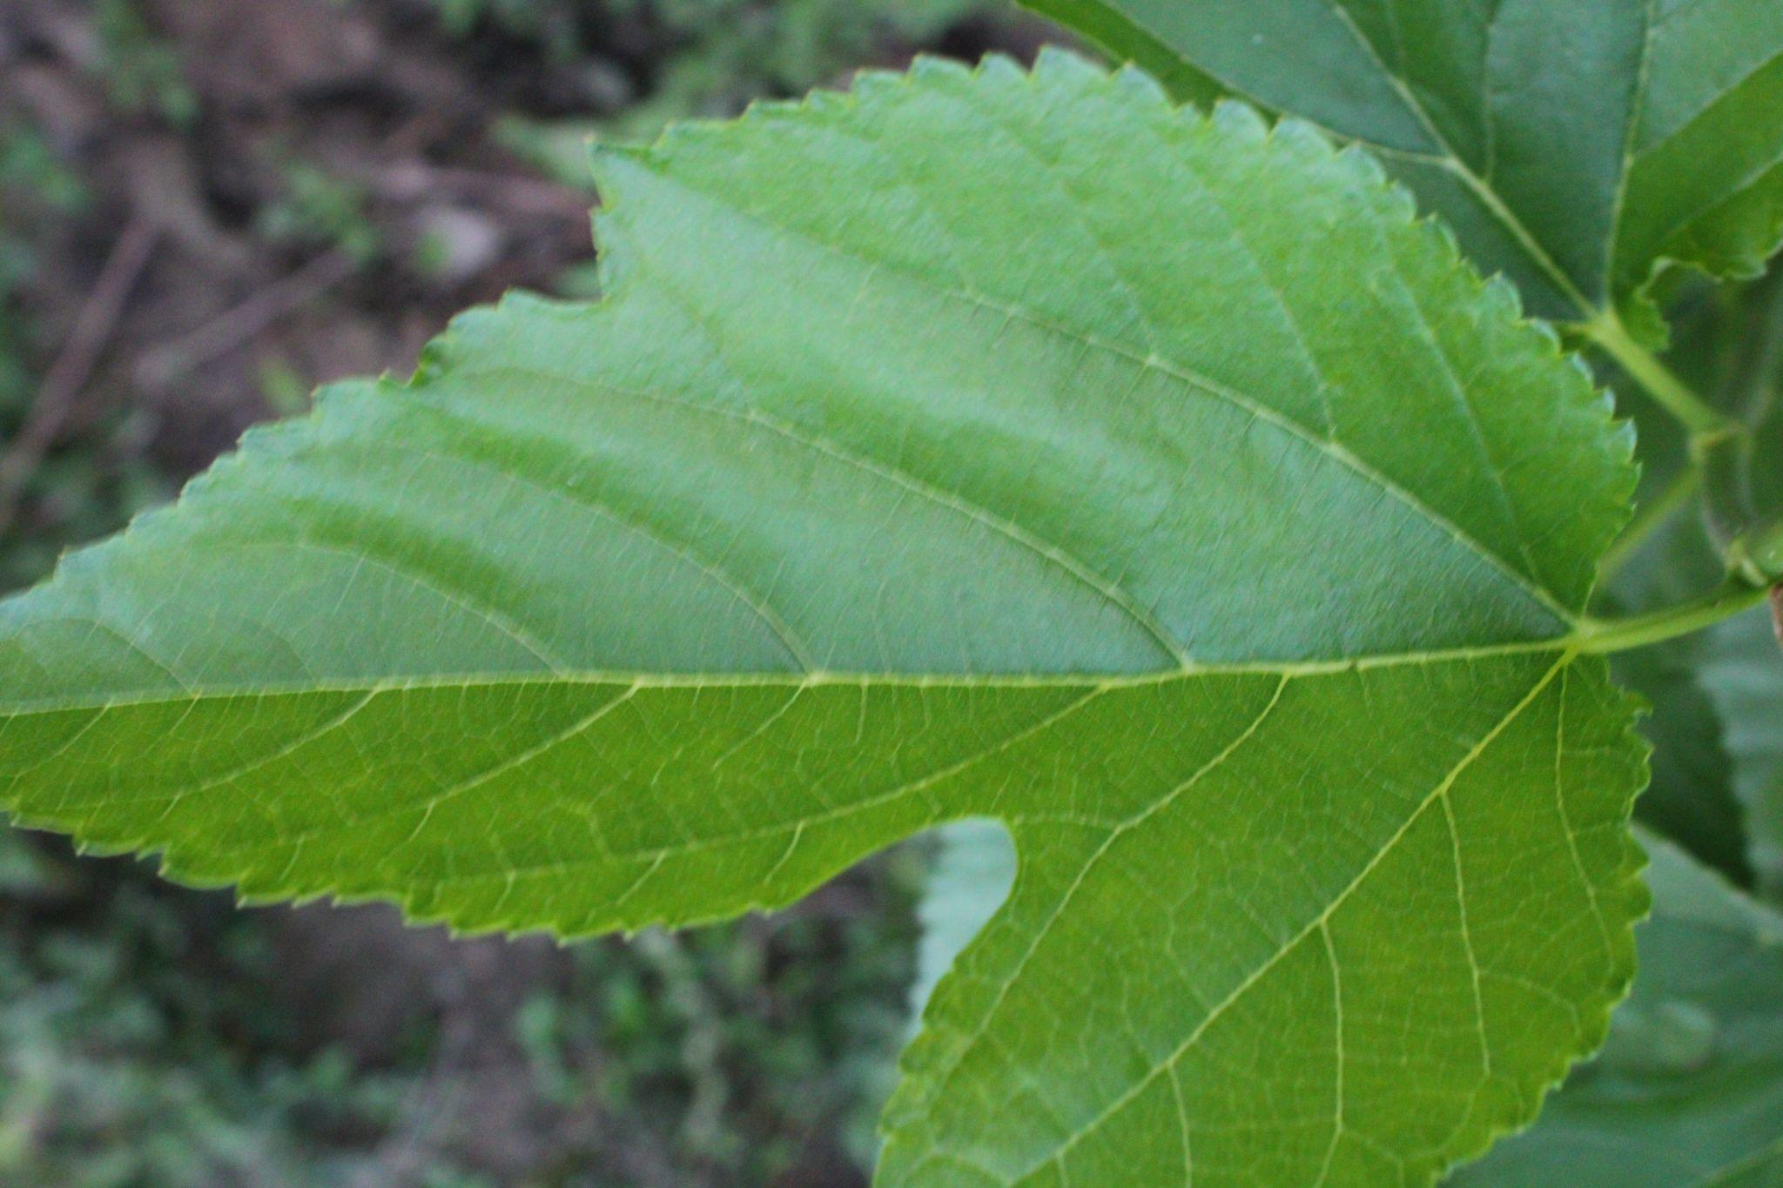
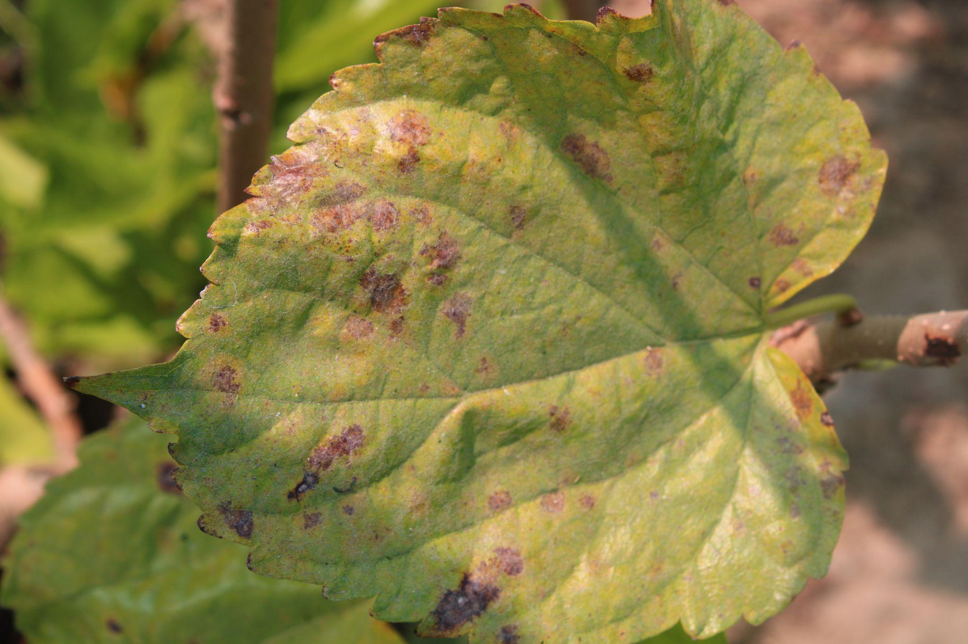
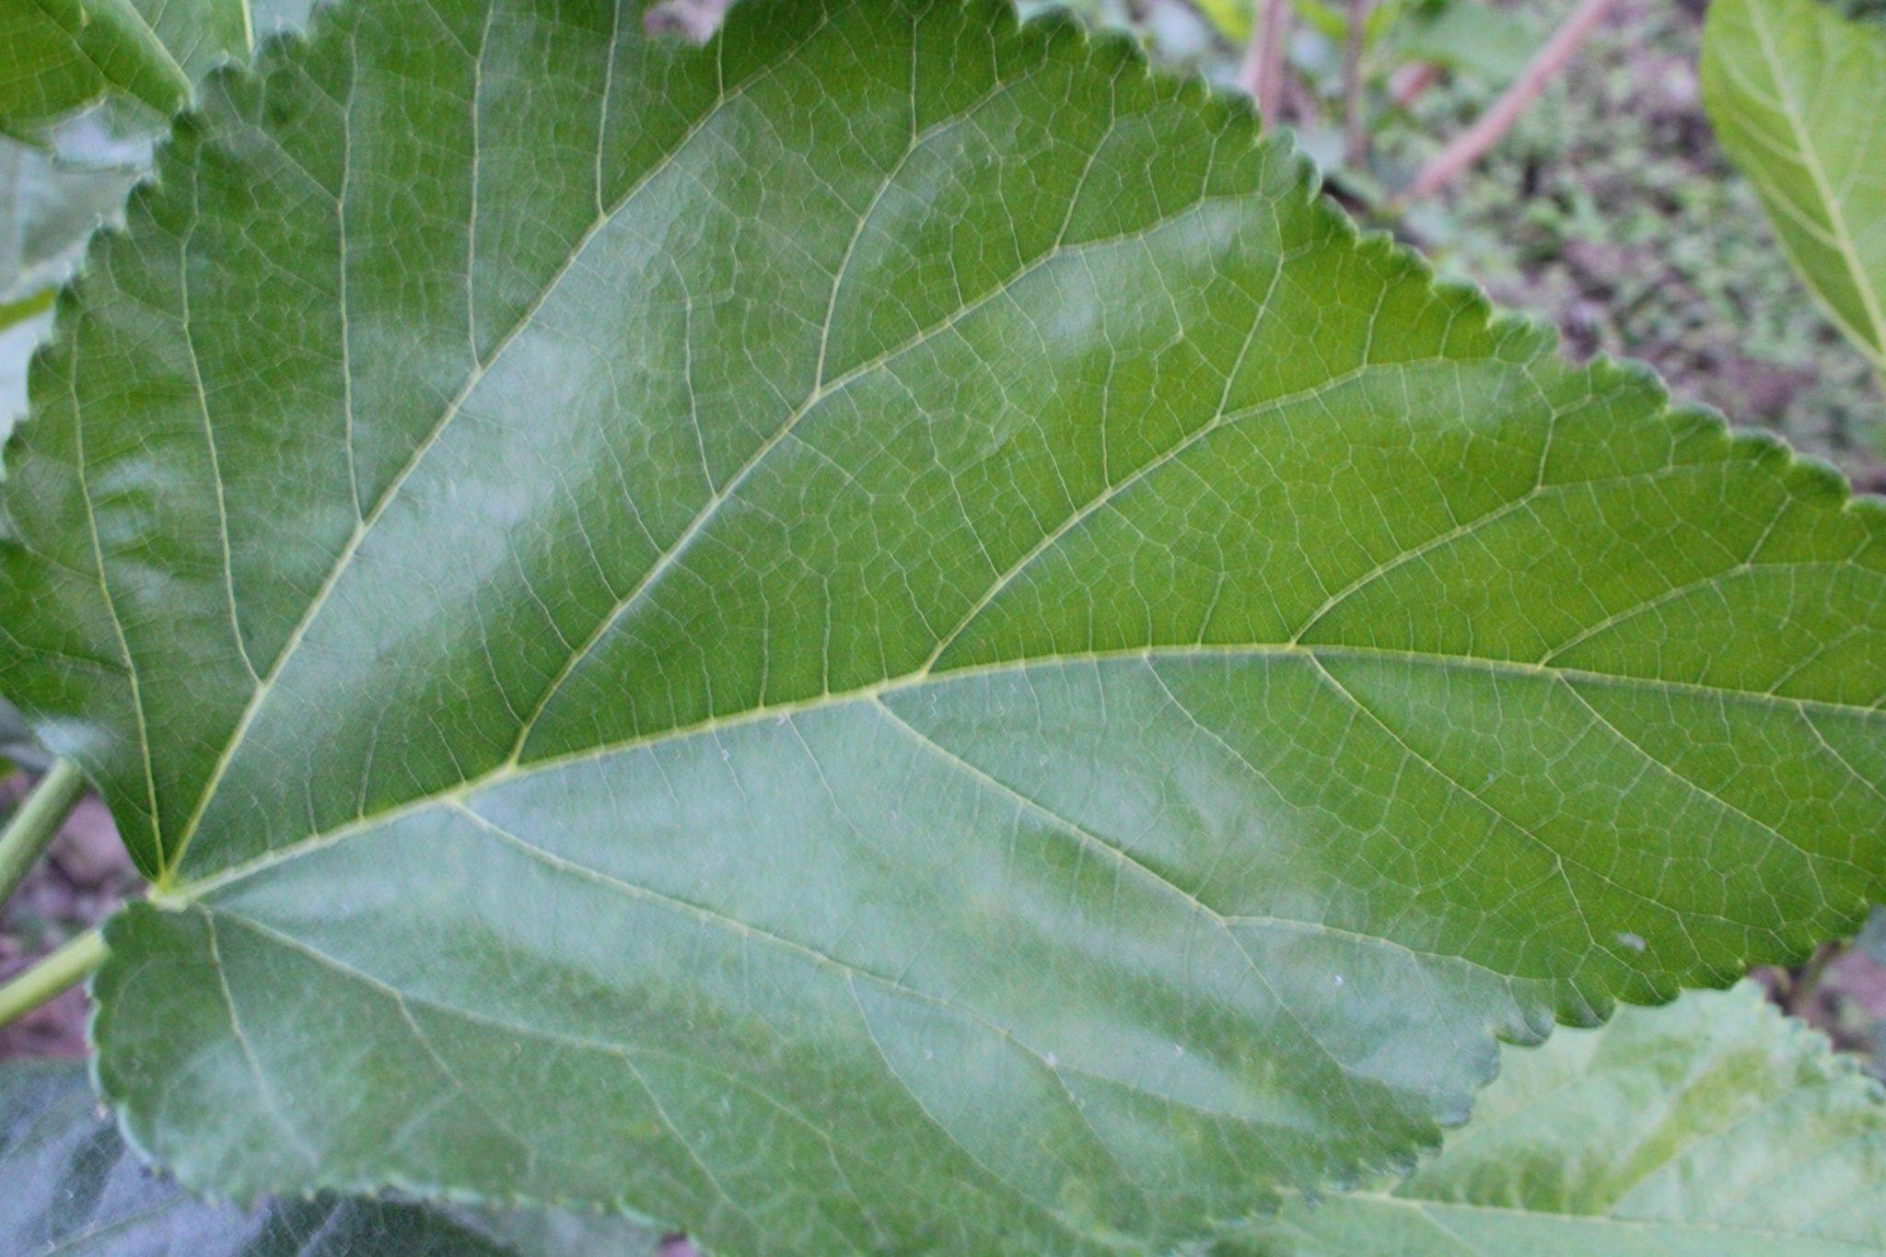

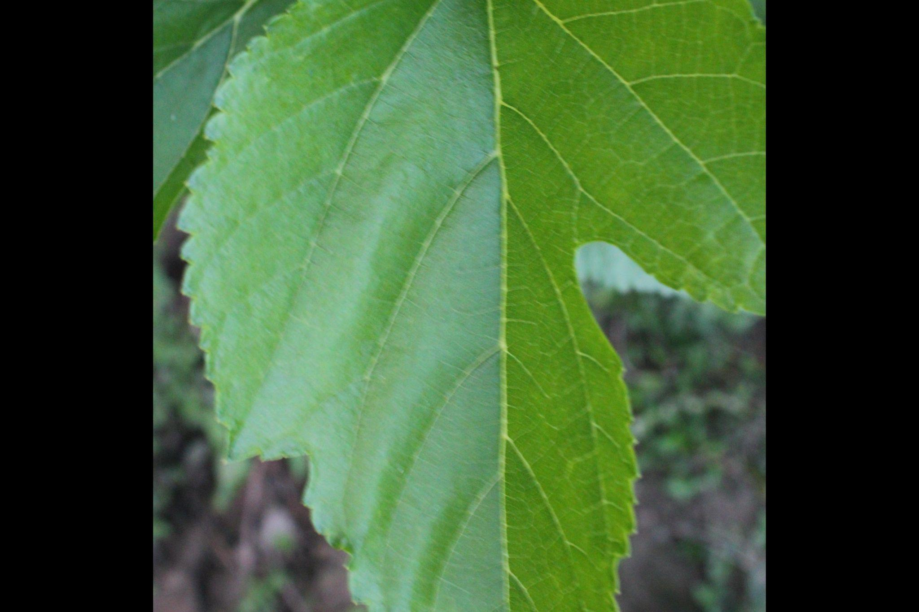
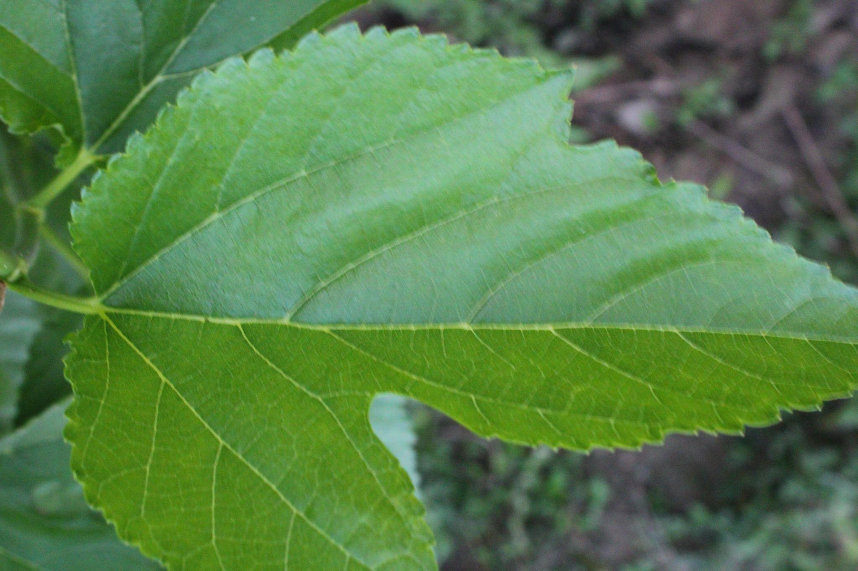
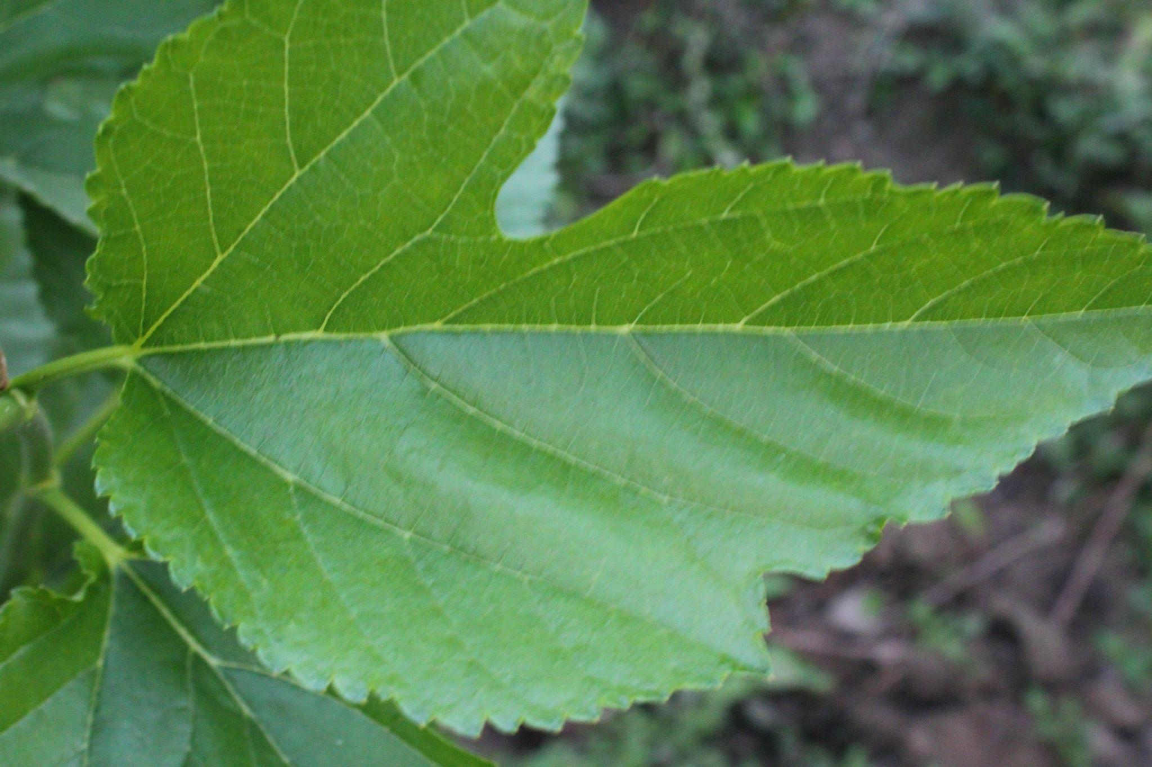
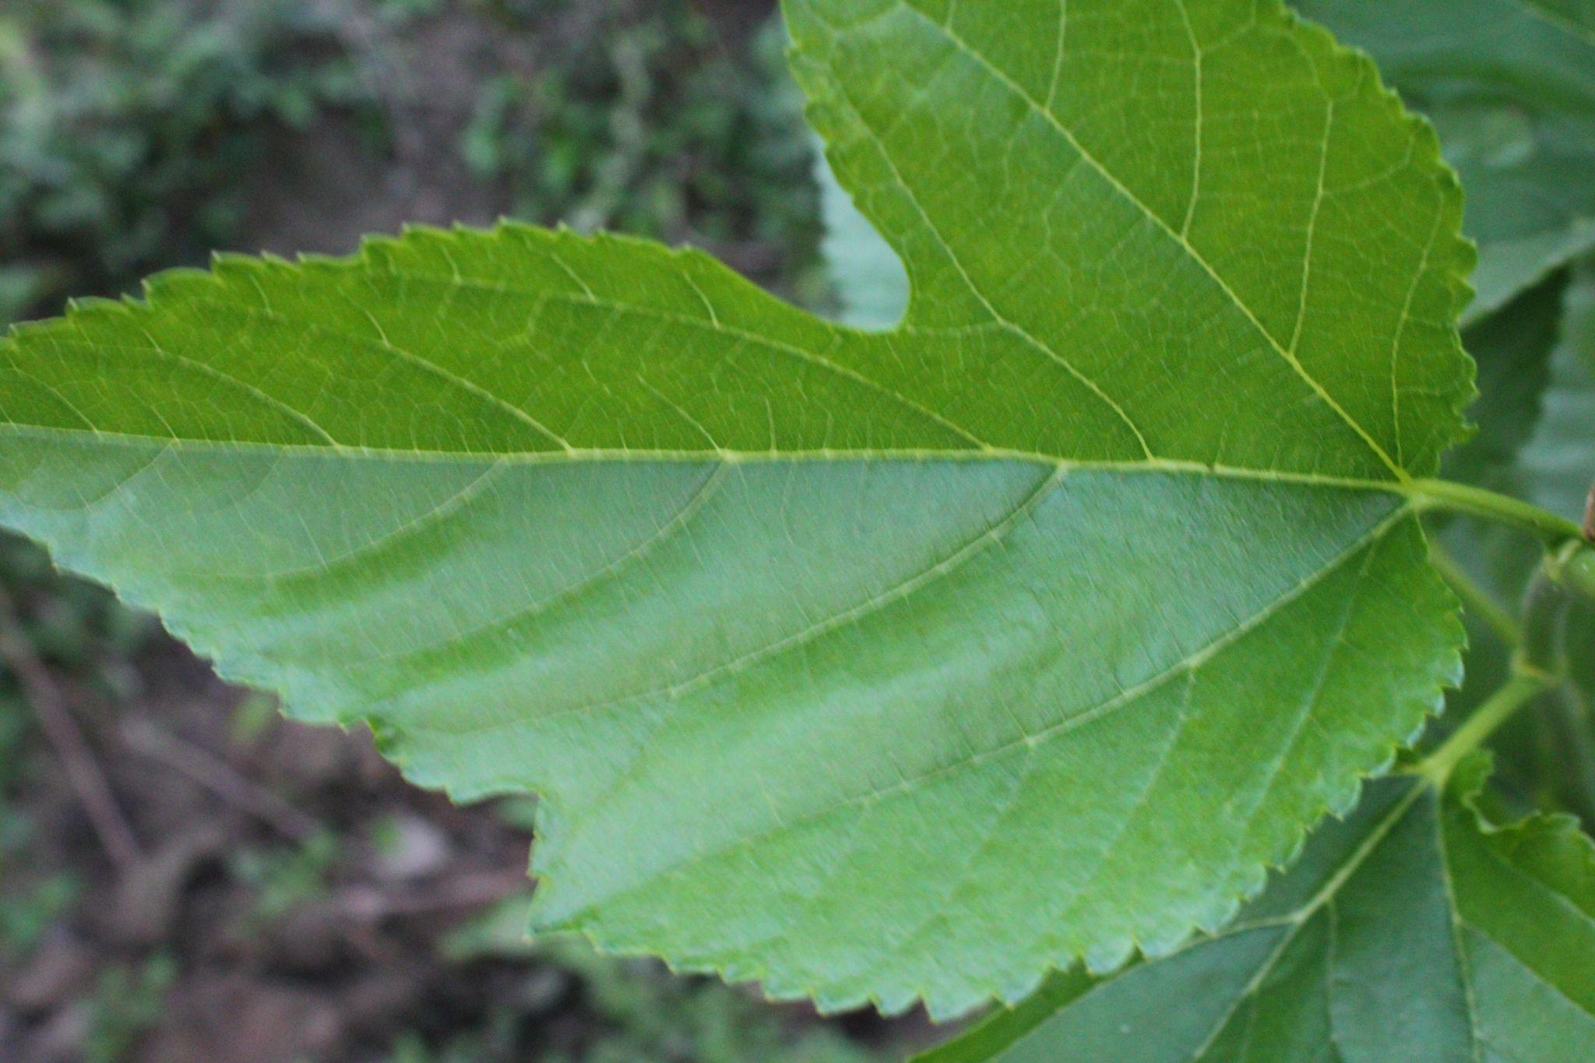
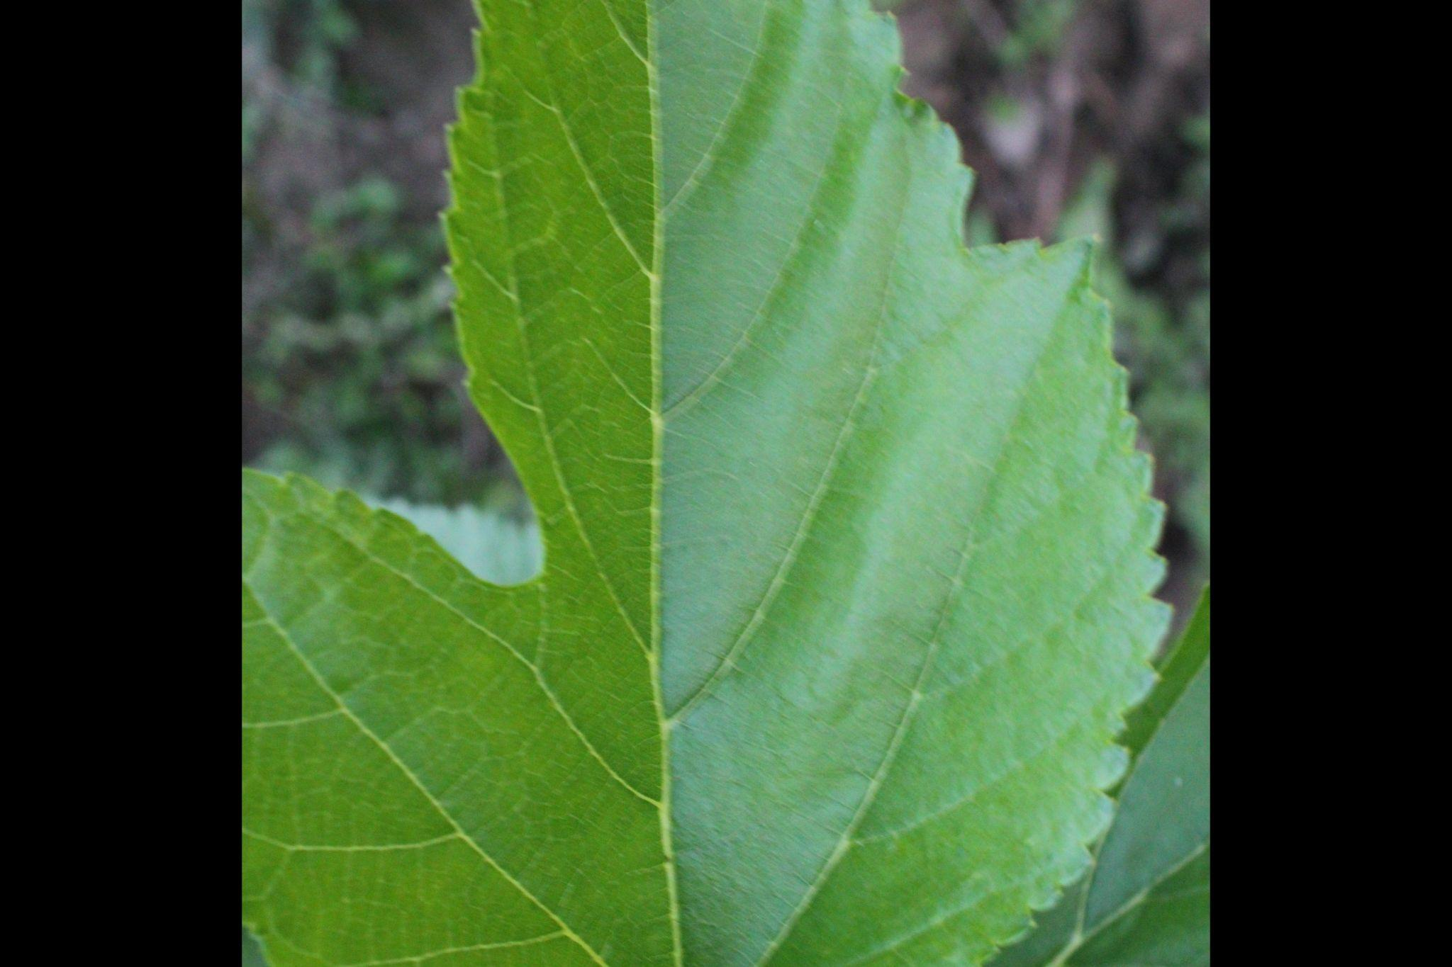
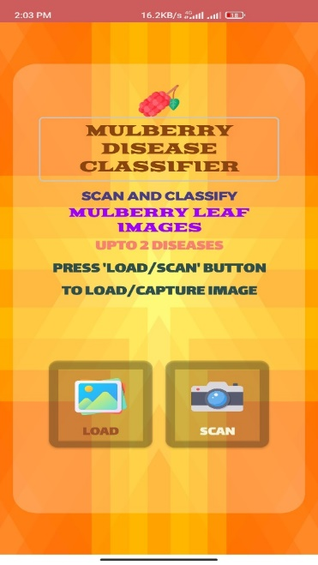
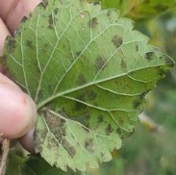
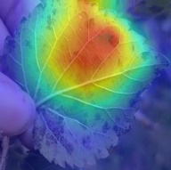
Reshaped Into
124 × 124
Rescaling
Dataset
Image Pre-proccessing
Image Splitting
Healthy
Leaf (0)
Training Models
Leaf
Spot (1)
Transfer Learning Models
Three-classes
CNN architecture
Leaf
Rust (2)
Image Augmentation
for Train Set
Saved Best Model
Grad-CAM
Visualization
Android Application

Slide 2
Dense Layers
MobileNetV3-Small
SoftMax
Disease Free Leaves
VGG 19
ImageNet
Dataset
Leaf Rust
Pre-trained
Models
Leaf Spot
ResNet 50
3
Classification
256
512
Trained on ImageNet Dataset
Predictions with Pre-trained Models

Slide 3
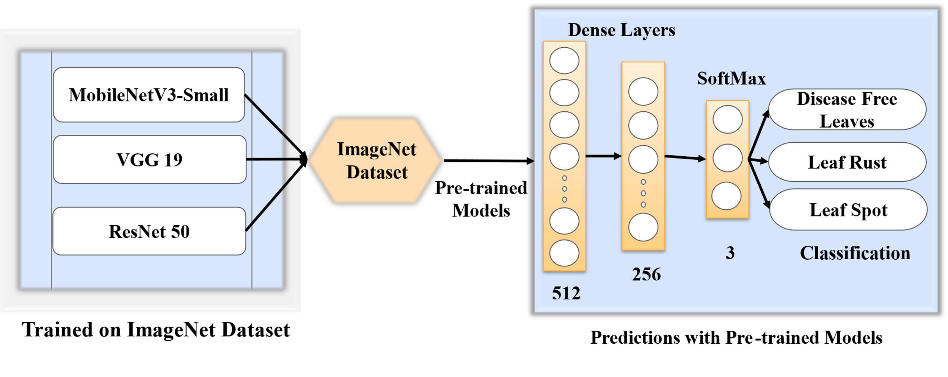
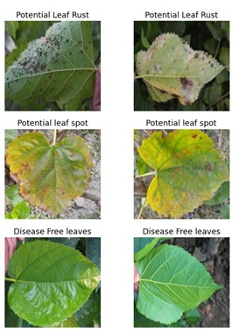
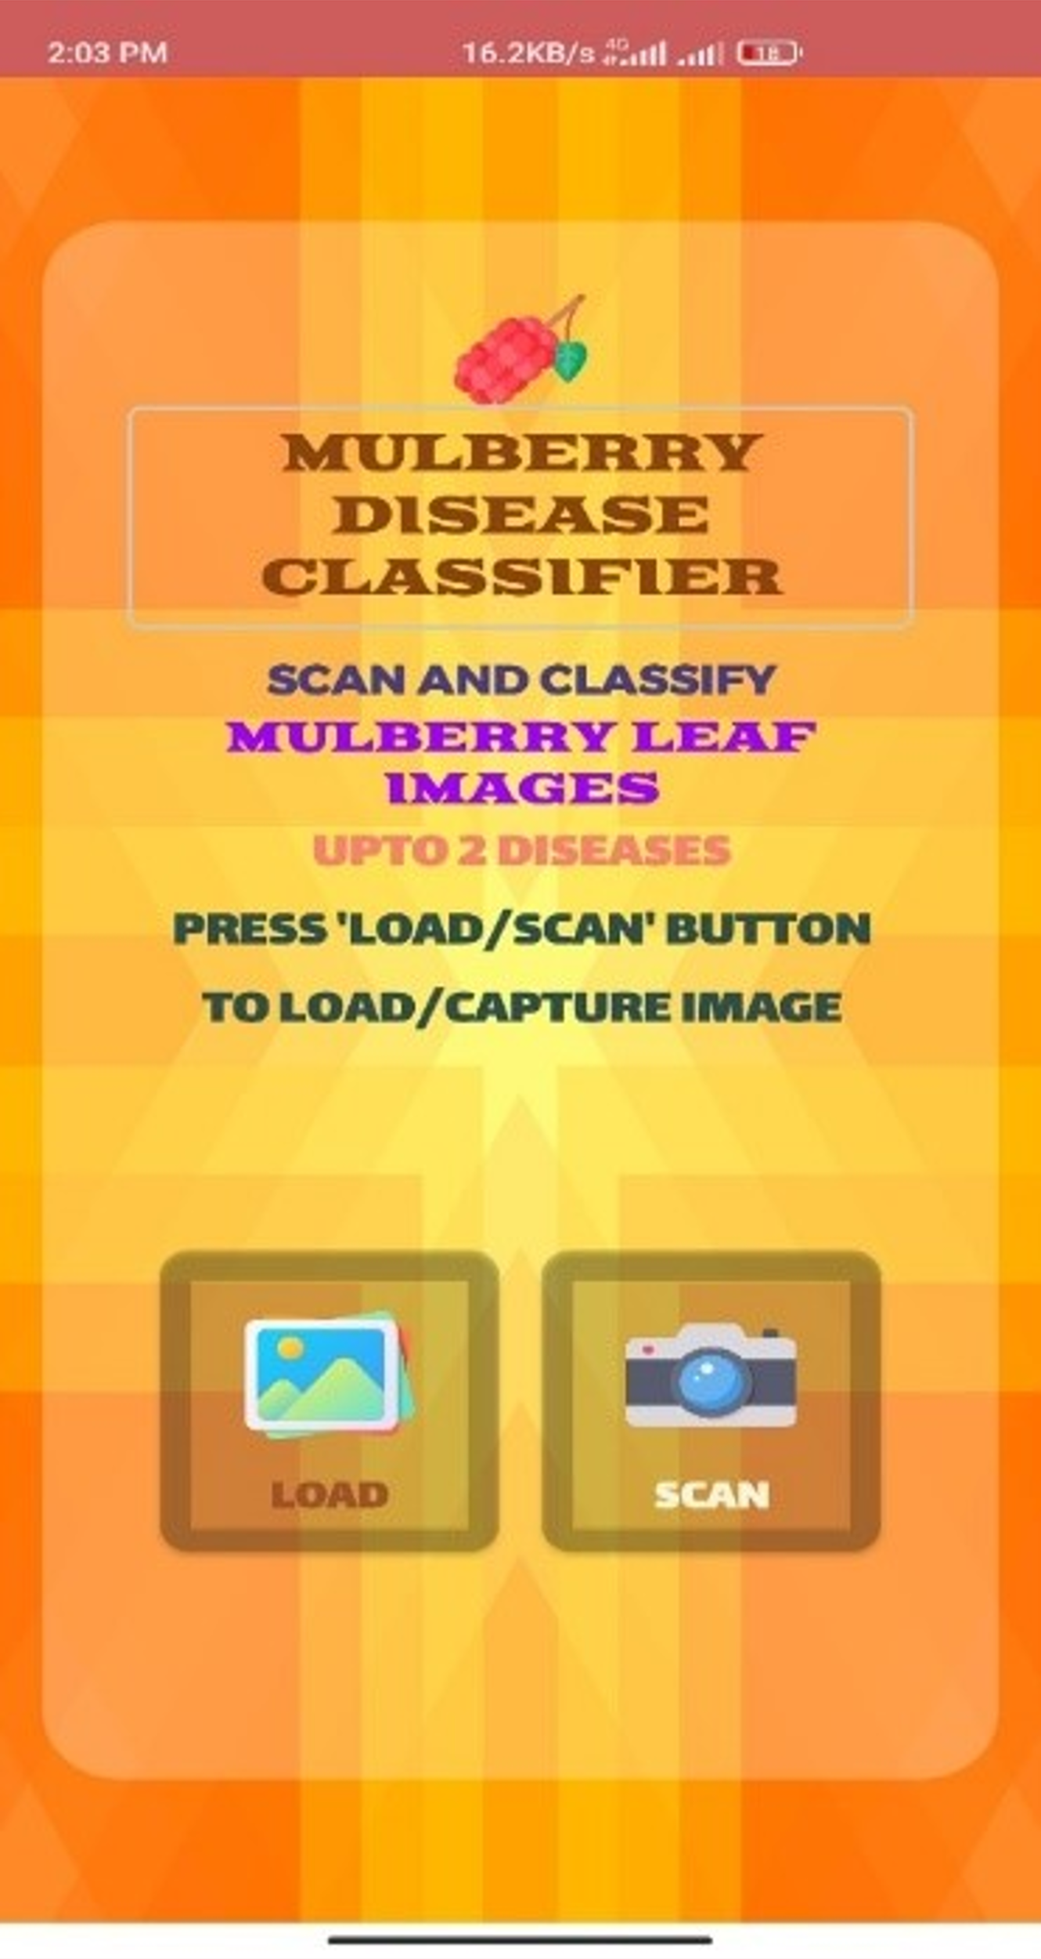
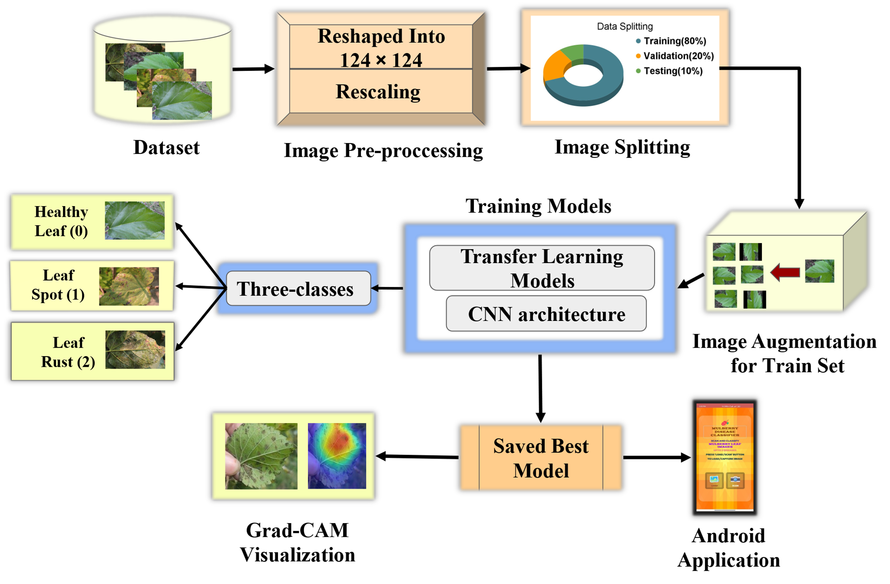
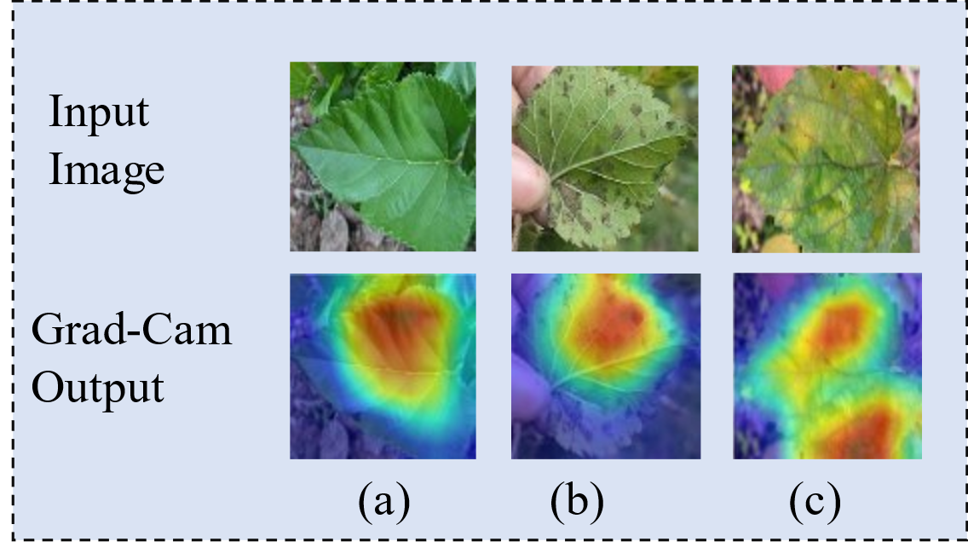
 | Mulberry Leaf Disease Detection. Modified MobileNetV3Small. Interpretability using Grad-CAM Visualization. AI-enabled Mobile Application.
Sample Images
Android Application
Proposed Methodology

Slide 4
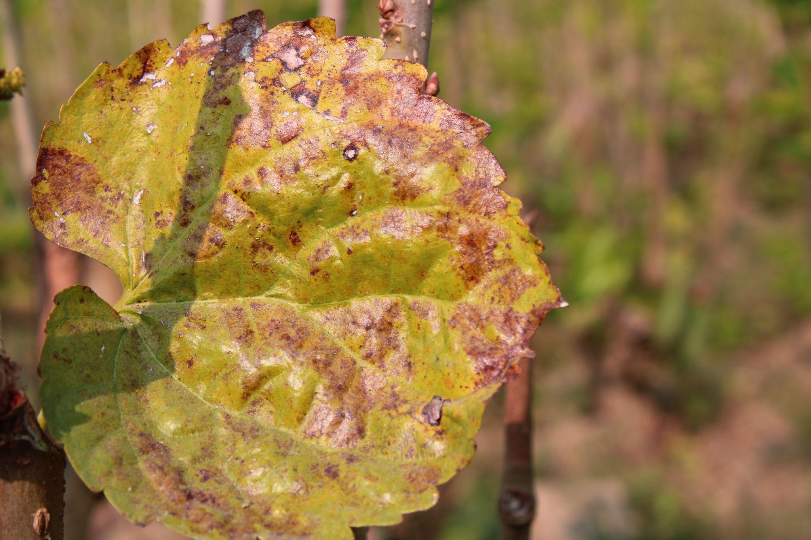
ImageNet
data
Classifier
Features from Pre-trained models
Out from BN
Dropout
FC
Healthy Leaf
Conv
512
Conv
128
Conv
64
Conv
32
Leaf Rust
Leaf Data
Sequential Model with additional conv layers
3
Leaf Spot
512
Classification
Classifier

Slide 5
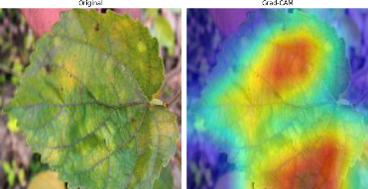
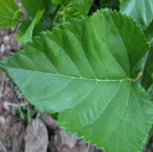

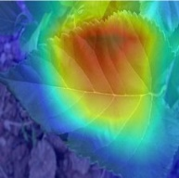
Original image
GradCam
 | (a) | (b) | (c)
Figure : Original and gradcam output for (a) Leaf Rust, (b) Leaf Spot, (c) Healthy leaves

Slide 6
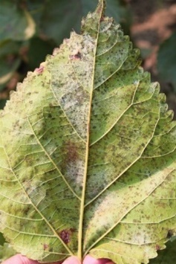
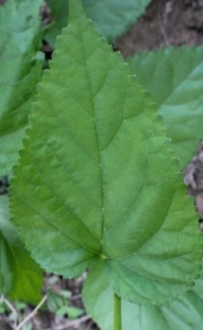
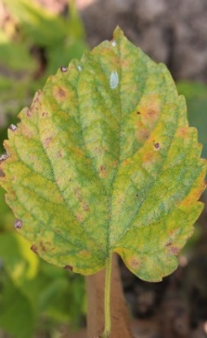
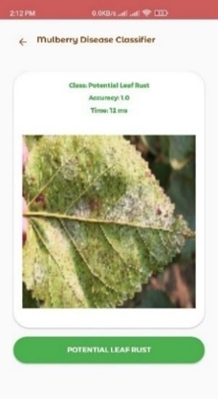
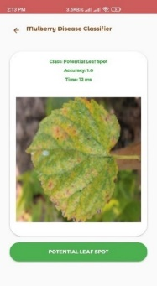
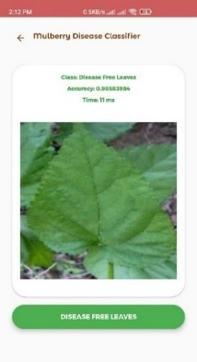
(a) | (b) | (c)
(a’) | (b’) | (c’)

